Slide 1
Group 12: Cryptocurrency Price Prediction and Investment Portfolio Optimization
Xintong Zheng, Xi Yan, Elaine Zhang, Wei Xiao, Jingbo Zhang
Date: 12/7/2022
Notes:
Main title: 40 pt. Arial
Presenter Name: 16 pt. Arial
Presenters Title: 16 pt. Arial Italic

Slide 2
Agenda
Problem Statement
Challenges
Data Sources and Processing
Methodology
Prediction Results
Optimization Results
Conclusion & Insights
Business impact
Potential Future Work

Slide 3






Problem Statement
Background:
As a digital asset, cryptocurrencies are active in the trading market. With more and more people starting to invest in cryptocurrencies, it is really interesting to dive deep into making prediction and optimizing portfolio investments.
Main questions:
predict price of cryptocurrencies based on their historical data
optimize potential cryptocurrency portfolio returns

Slide 4
Challenges
Accuracy of prediction: Due to the high volatility of the cryptocurrencies market and the constantly changing macroeconomics, it is hard to make accurate prediction.
Feature engineering: During the process of optimization or prediction, solely relying on the performance of cryptos are not enough, we have to also do feature engineering to generate quantitative indicators.
Model Selection: We have to think about the selection of models since it is not necessarily linear. It is very challenging to find a model that simulates the cryptocurrencies market as most as possible.

Slide 5
Project Flow & Objectives
Short-term (1 day) portfolio optimization to maximize profit based on predicted price
Machine Learning prediction on tomorrow’s close price
Data Preprocessing
Time Series Forecasting on tomorrow’s close price
Short-term (1 day) portfolio optimization to maximize profit based on predicted price
Long-term (1 month) portfolio optimization to minimize risks

Slide 6
Data Sources and Processing
Top 100 Cryptocurrencies Historical Data is retrieved from Kaggle whose usability scores 8.24.
For each cryptocurrency, we have 7 original features, which include:
Date (Date of the crypto prices)
Open (Opening price of crypto on the respective date)
High (Highest price of crypto on the respective date)
Low (Lowest price of crypto on the respective date)
Close (Closing prices of crypto on the respective date)
Volumn (Volume of crypto on the respective date)
Currency (Type of currency)
We build data pipelines to process 93 valid cryptocurrencies:
For prediction, we generate quantitative indicators based on the Open, High, Low, Close (OHLC) price to better fit with models.
For optimization, we select one-day Open and Close price for short-term portfolio and Close price for a month for long-term optimization

Slide 7
Methodology: Machine learning
Goal: Predict the % change of next day’s closing price compared to closing price a day before.
Output: predicted % change of close price on 8/28/2021 compared to 8/27/2021 for each cryptocurrency
Try on a random dataset
After the approach, apply to all the 93 datasets
Approach:
Feature Engineering
Cleaning, Train-Test Split, and Scale
Try out 6 types of Regression
Statistical & Financial metrics evaluation of each model
Predict using the suitable model

Slide 8
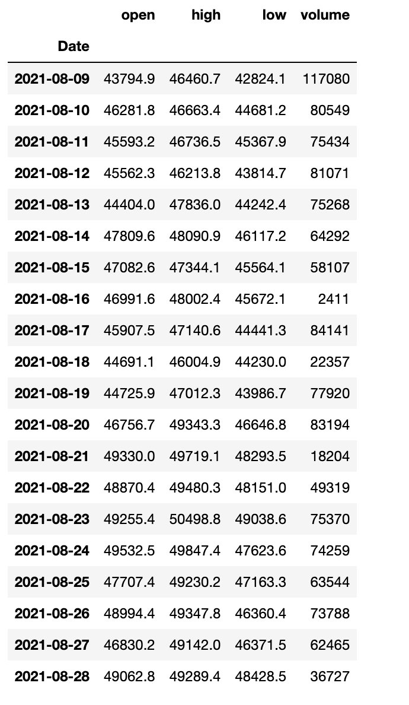
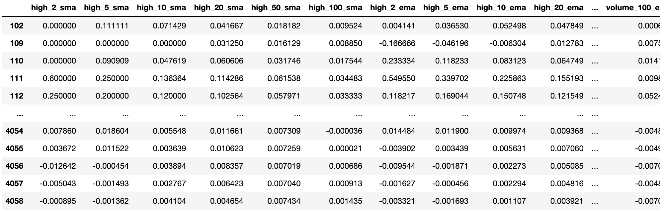
Methodology: Machine learning
Feature engineering: for each crypto:
Only use [high, low, volume], convert it to [2, 5, 10,20, 50, 100] days of [simple, exponential, standard deviation, variance] Moving Average. And then convert it to
% change compare to previous day. (To make sure we are not ‘peeking’ the future data, and using only the knowable data)
Get rid of Date as well

Slide 9
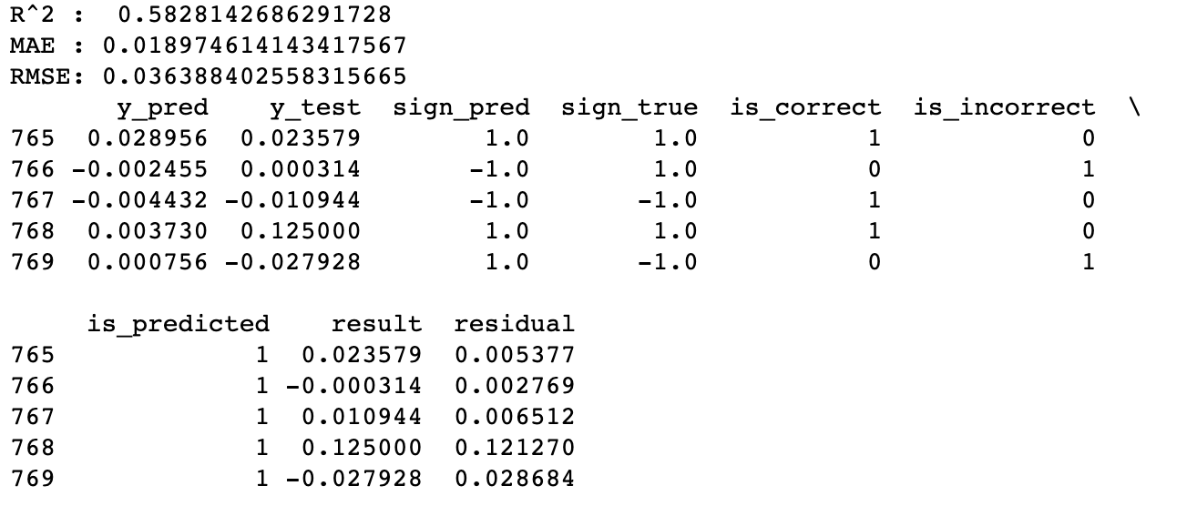
Methodology: Machine learning
Set up metrics
Evaluation: Statistics
Evaluation: Financial
sign_pred: positive or negative sign of prediction
sign_true: positive or negative sign of true outcome
is_correct: 1 if sign_pred == sign_true, else 0
is_incorrect: opposite
is_predicted: 1 if the model has made a valid prediction, 0 if not. This is important if models only emit predictions when they have a certain level of confidence
result: the profit (loss) resulting from betting one unit in the direction of the sign_pred.
residual: the absolute value of prediction compare to the true value

Slide 10
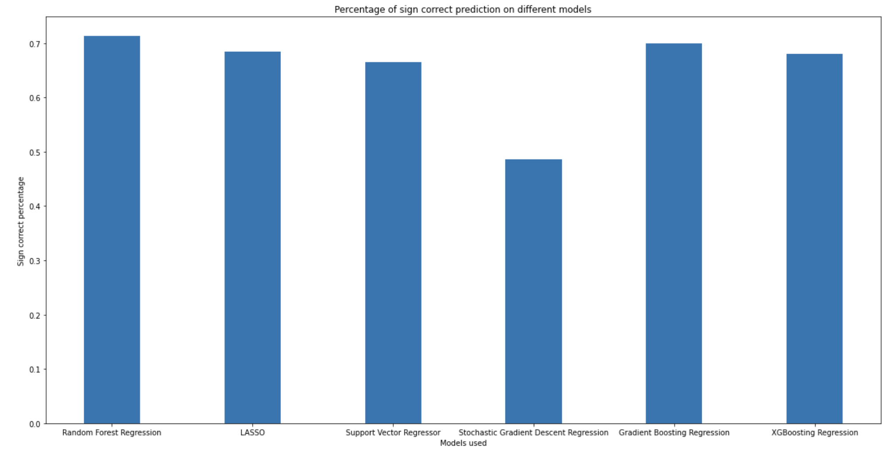
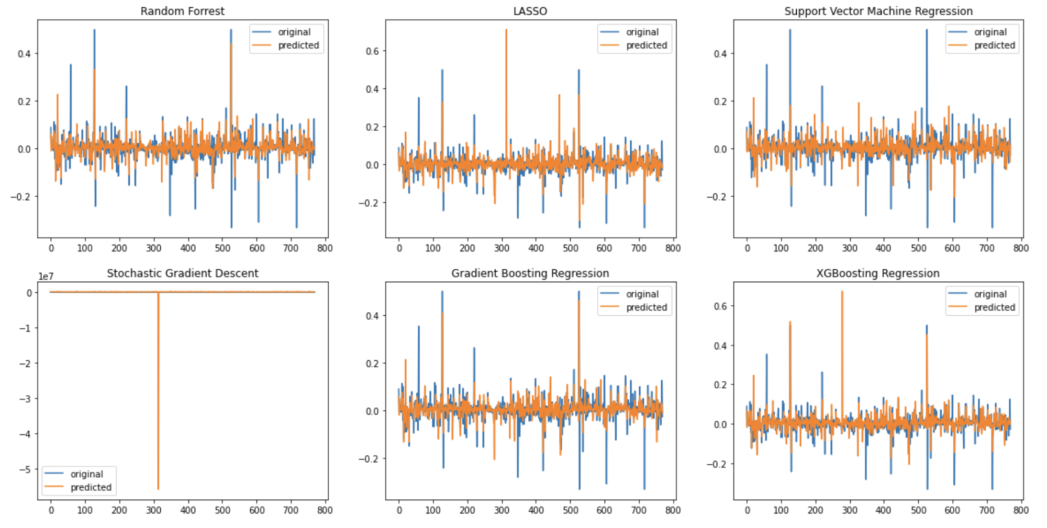
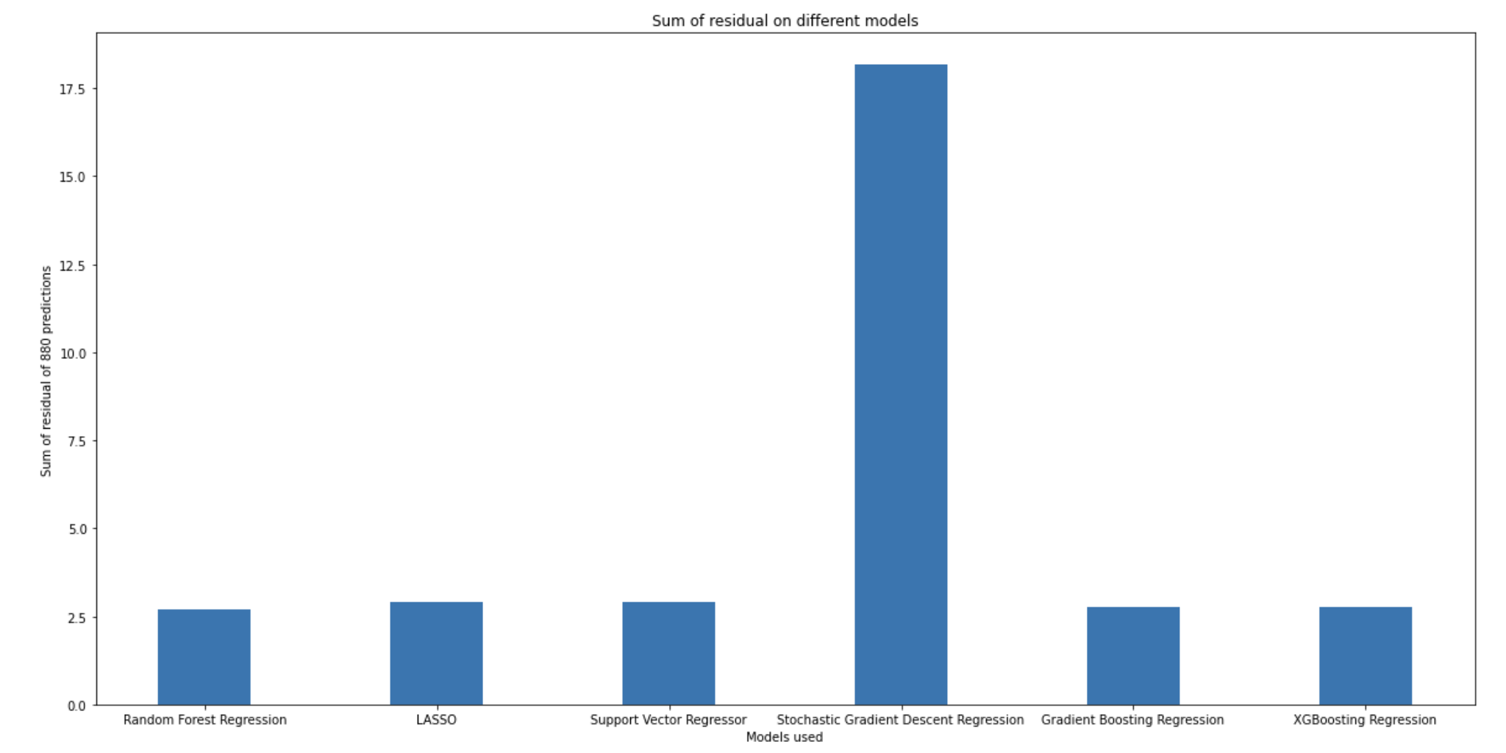
Methodology: Machine learning
Metrics of visualization of 6 regression models: [Random Forest Regression, LASSO,
Support Vector Machine Regression,
Stochastic Gradient Descent, Gradient Boosting,
XGboosting Regression]
(We observe that Bagging and Boosting is better than Linear)
Percentage of ‘sign_pred’ == ‘sign_true’ on different models
Test model in test-set
Sum of residual on different models

Slide 11
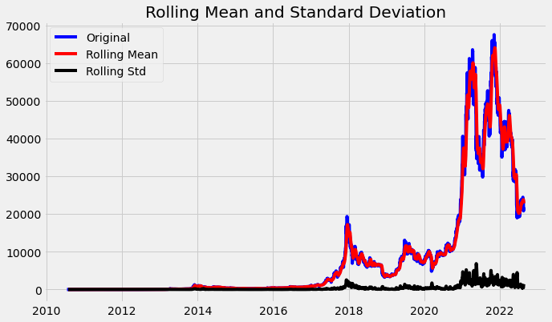
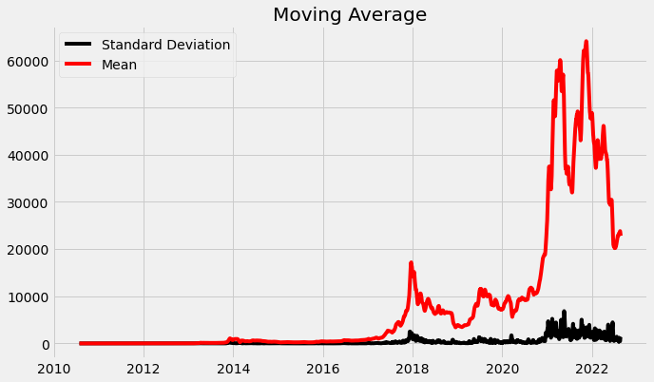
Methodology: ARIMA
AutoRegressive Integrated Moving Average
Goal: time series forecasting
Output: predicted close price on 8/28/2021 for each cryptocurrency
Test on a random dataset
Auto Apply to all the 93 datasets
Approach:
Test for stationarity: ADF test
Separate the trend and decompose the series
Eliminate trend
Split data to training and testing set
Use auto-ARIMA identify the most optimal parameters
p: The number of lag observations included in the model
d: The number of times that the raw observations are differenced
q: The size of the moving average window
Build model based on the selected optimal parameters
Forecast

Slide 12
Methodology: Optimization
maximize expected profits (one-day)
Without prediction
(Ideal but not practical)
Short-term optimization
With prediction: Machine Learning & ARIMA
Optimization
Long-term optimization
minimize portfolio risk

Slide 13
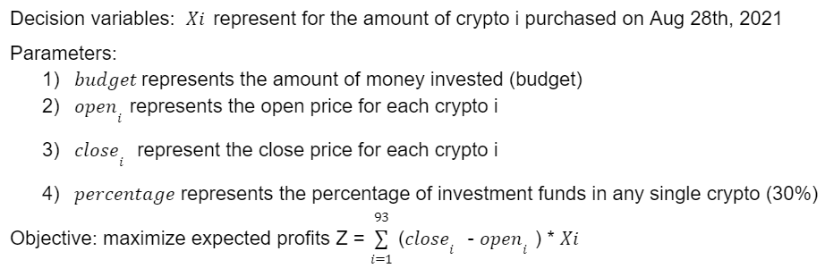
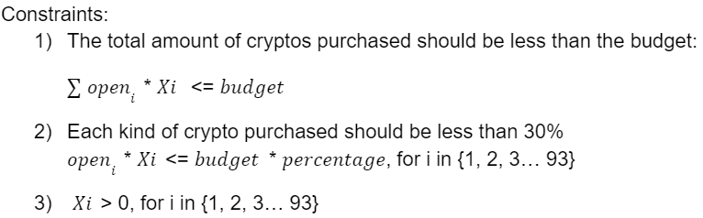
Methodology: Short-Term Optimization (Without Prediction)
(Ideal but not practical)

Slide 14
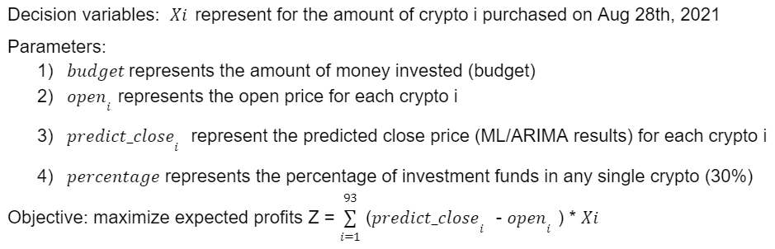
Methodology: Short-Term Optimization (With Prediction)

Slide 15
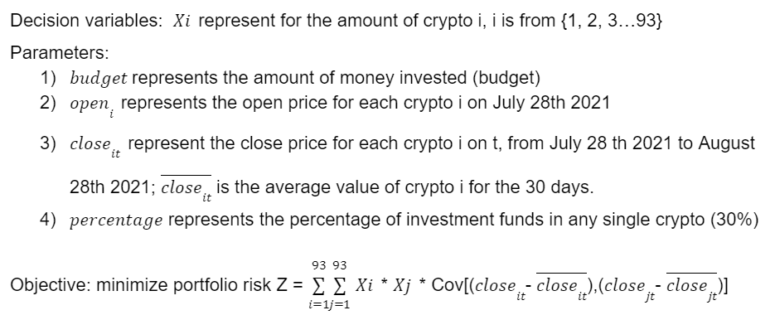
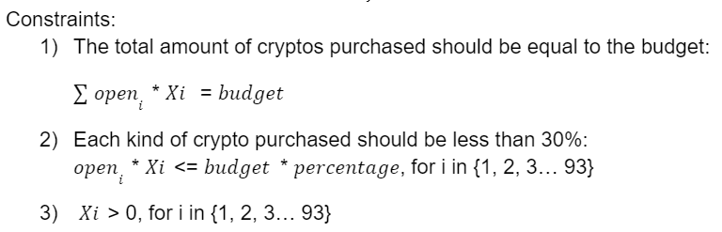
Methodology: Long-Term Optimization

Slide 16
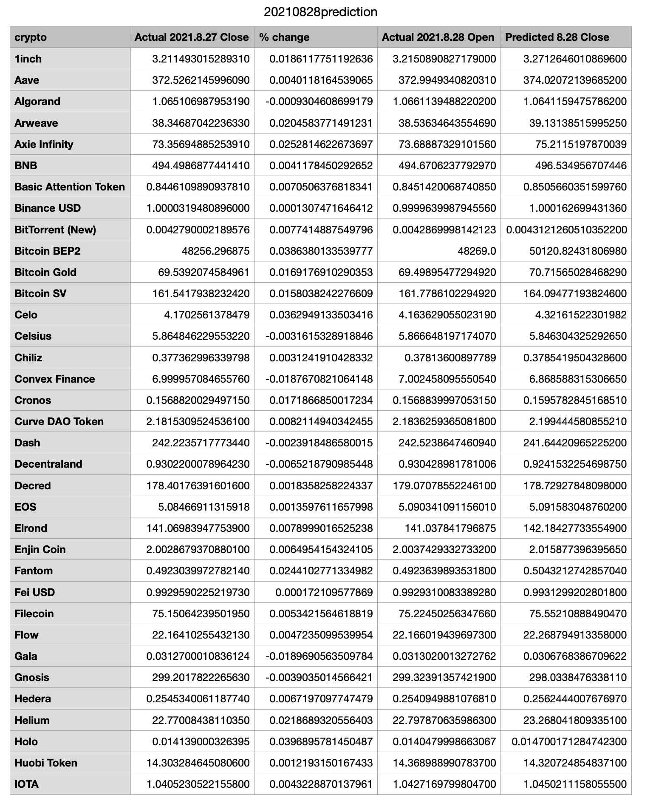
Machine Learning Prediction Results
Predicting the close price for each cryptocurrency on August 28, 2021
Output: csv file
% Change,
Predicted 8.28 Close price

Slide 17
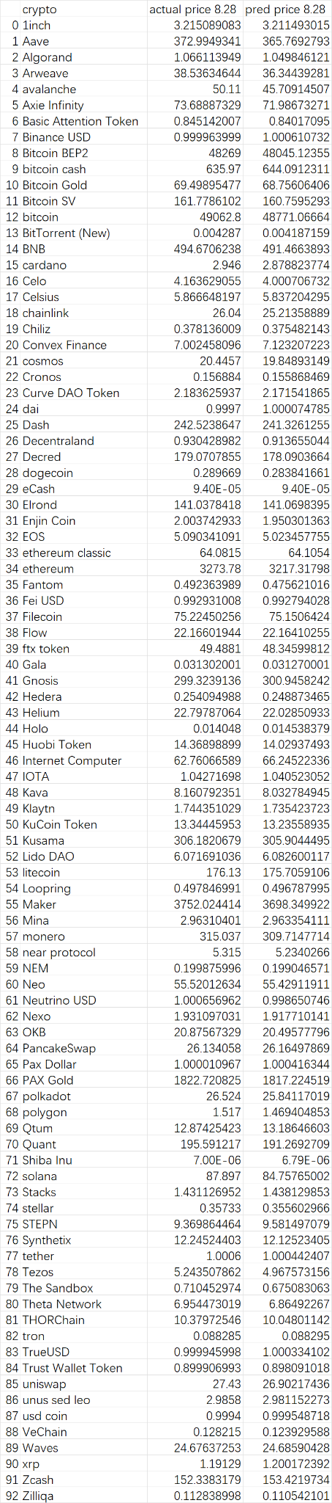
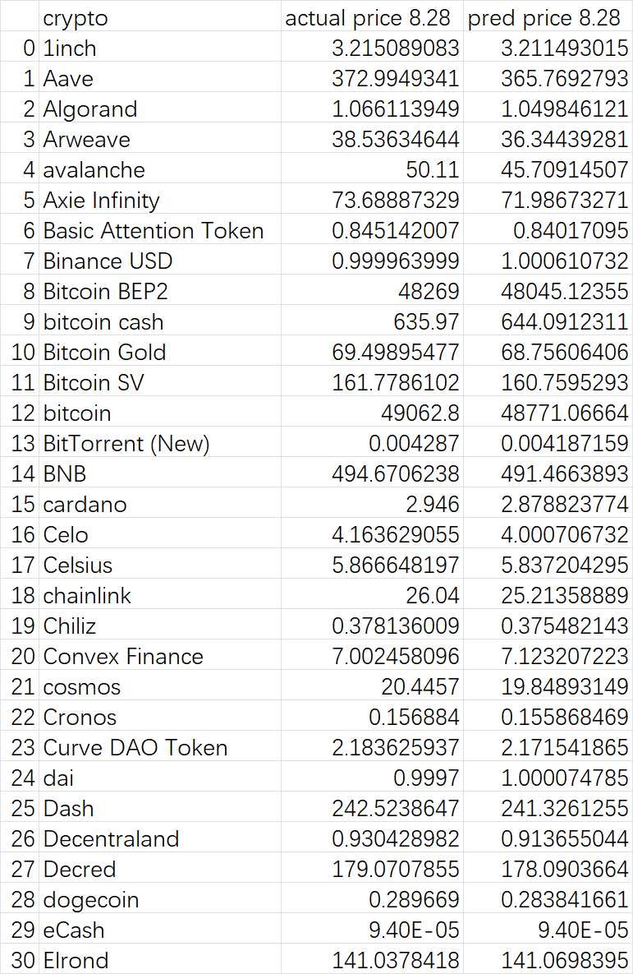
ARIMA Prediction Results
Predicting the close price for each cryptocurrency on August 28, 2021
Output: csv file
Actual open price
and
Predicted close price

Slide 18
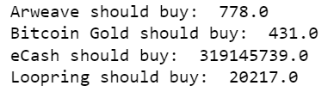
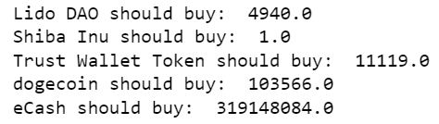
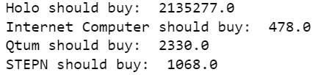
Short-Term Optimization Results
Optimal Value: $31,386
Optimal Investment Plan:
Without prediction
(Ideal but not practical)
$100,000 budget
ML
Optimal Value: $7,971
Optimal Investment Plan:
Actual profit: $18,088
With prediction
Optimal Value: $3,666
Optimal Investment Plan:
Actual profit: $2,741
ARIMA

Slide 19
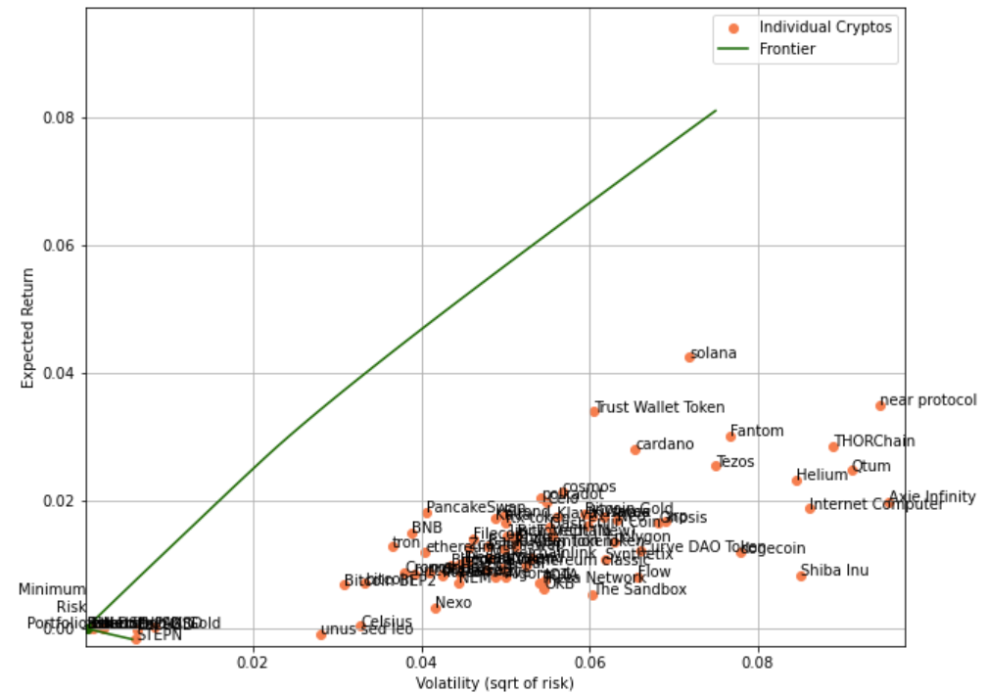
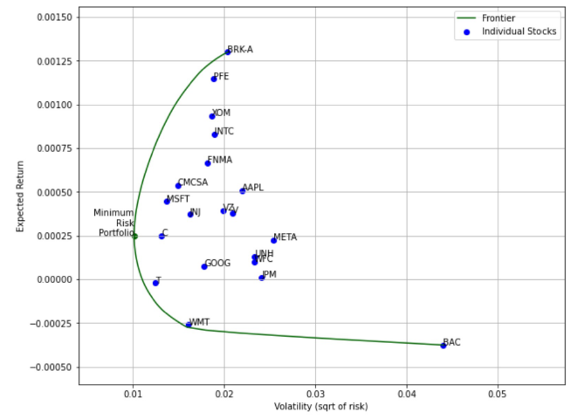
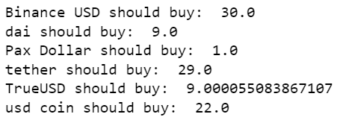
Long-Term Optimization Results
Minimize portfolio risk with a budget of $100
reward >= 0
Optimal Value: 0.00026 (Volatility)
Optimal Investment Plan:

Slide 20

Conclusions & Insights
When total budget is $100,000, on 8/28/2021, in 1 day:
Short-term optimization & without prediction: $31,386 (31.4% up in 1 day)
Short-term optimization & with machine learning prediction: $18,088 (18.1% up in 1 day)
Short-term optimization & with ARIMA prediction: $2,741 (2.74% up in 1 day)
(If you want us to help you make crypto investment plans, email us after the presentation )
According to the optimal values, on 8/28/2021, both of machine learning model and time series model can generate profit. On that day, Machine learning prediction can generate more profit than ARIMA prediction.
When total budget is $100:
Long-term optimization : volatility 0.00026

Slide 21
Business Impact
As an investor:
Profitability or losing less money are what investor all ultimately care about. Our model can make profits (or at least did not lose money).
Being able to rely on models to forecasts prices in the future is more preferable in the investment decision making process than “guessing” what the price will be only by looking at the market fundamentals and market sentiments.
As a portfolio manager:
Optimizing on the performance based on a specific objective (maximize profit in short-term or minimize risk in short-term) can satisfy client’s needs and is able to find the optimal portfolio given the information and knowledge we have. The better the model, the more trust from our clients.

Slide 22
Potential Future Work
More features on macro-economic aspects (GDP growth, interest rates… etc).
Try out time series methods, neural networks such as LSTM and compare the performance.
If computational power permitted, hyperparameter tuning for each of the model for each of the crypto to find the best parameters.
If computational power permitted, increase the long-term optimization budget.
For time-series model, test on more days to see if model performance variates.

Slide 23
References
“Stock Prediction with ML: Model Evaluation — The Alpha Scientist.” Accessed December 1, 2022. https://alphascientist.com/model_evaluation.
Saha, Raj. “Forecasting of Stock Market Using ARIMA in Python.” Medium (blog), April 27, 2022. https://medium.com/@raj.saha3382/forecasting-of-stock-market-using-arima-in-python-cd4fe76fc58a.
Zhuang, Cedric. “Stockstats: DataFrame with Inline Stock Statistics Support.” OS Independent, Python. Accessed December 1, 2022. https://github.com/jealous/stockstats.
“Portfolio.Ipynb: Decision Analytics for Business and Policy.” Accessed December 1, 2022. https://canvas.cmu.edu/courses/30486/files/8510975?module_item_id=5273179.

Slide 24
Thank You!
Q&A

